Slide 1
Web Development
HTML and CSS

Slide 2
Get user input using Forms

Slide 3
OBJECTIVES
In this chapter you will learn how to:
Use forms to get user input
Deploy various HTML elements to interact with users

Slide 4



ListBox and Dropdown Lists
Listbox
Dropdown list
<select size="3">
<option>Java</option>
<option>C#</option>
<option>VB</option>
<option>PHP</option>
</select>
<select>
<option>Java</option>
<option>C#</option>
<option>VB</option>
<option>PHP</option>
<option>Ruby</option>
</select>

Slide 5


Radio buttons and Check boxes
<h3>Select a drink</h3>
<input type="radio" name="drink" value="t" />Tea
<input type="radio" name="drink" value="c" checked />Coffee
<input type="radio" name="drink" value="s" />Soup
<h3>Other options</h3>
<input type="checkbox" name="milk" value="y" />Milk
<input type="checkbox" name="sugar" value="y" />Sugar

Slide 6
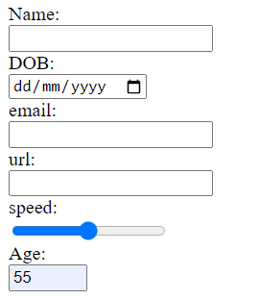
More user input elements
Name: <input type="text" name="name">
DOB: <input type="date" name="dob">
email:<input type="email" name="email">
url: <input type="url" name="url">
speed:<input type="range" name="speed">
Age: <input type="number" name="age" min="1" max="65">
Self-validating elements

Slide 7

Forms
Forms get information from the users to your server program
Form element may have an action and method attribute (seen later)
Submit button will submit the form data
<form action="serve.asp" method="get">
<input type="radio" name="drink" value="t" checked>Tea
<input type="radio" name="drink" value="c">Coffee
<input type="radio" name="drink" value="s">Soup<br />
<input type="checkbox" name="milk" value="y">Milk
<input type="checkbox" name="sugar" value="y">Sugar<br />
<input type="submit" value="Vend">
</form>

Slide 8
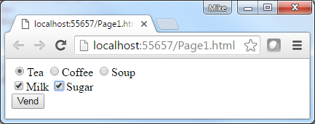

Forms – action and method attributes
<form action="Page2.html" method="get">
<form action="Page2.html" method="post">
Action
Address where Form's data is sent when submit is clicked (defaults to the same page)
POST
Form data placed in the Body of the HTTP request
GET (default)
Information placed on the URL limited by the browser URL max length, Users can edit it and hard to bookmark

Slide 9
Cookies
Small data storage that are either stored in the client's browser memory or as text files on the client machine
Useful for containing information about the user
Limited to a session (Session cookie) if not stored in permanent files
Lifetime of the cookie can programmatically be set in code
If saved as files they are easily accessible by clients/hackers
Can only be read from the originator domain
BBC.com cannot read cookies created by QA.com
HTML5 provides other means of client-side storage mechanisms
Server side Sessions are an alternative
Store information for an IP address on the host server
Cookies are strictly bound by law and any website using them needs permission from each user

Slide 10
Summary
In this chapter you learned how to:
Create forms
Method
Use HTML elements to get the user input
<form action="Page2.html" method="get">
<input type="radio" name="sex" value="f">Female
<input type="radio" name="sex" value="m" checked>Male
<input type="checkbox" name="CheckMilk" value="Yes">Milk
<input type="text">
<input type="number" min="1" max="9">
</form>

Slide 11
LAB
In this lab you will
Gather student details using forms
You will use the get and post methods
Please refer to lab "Get user input using Forms"
Duration 20 minutes

